Slide 1
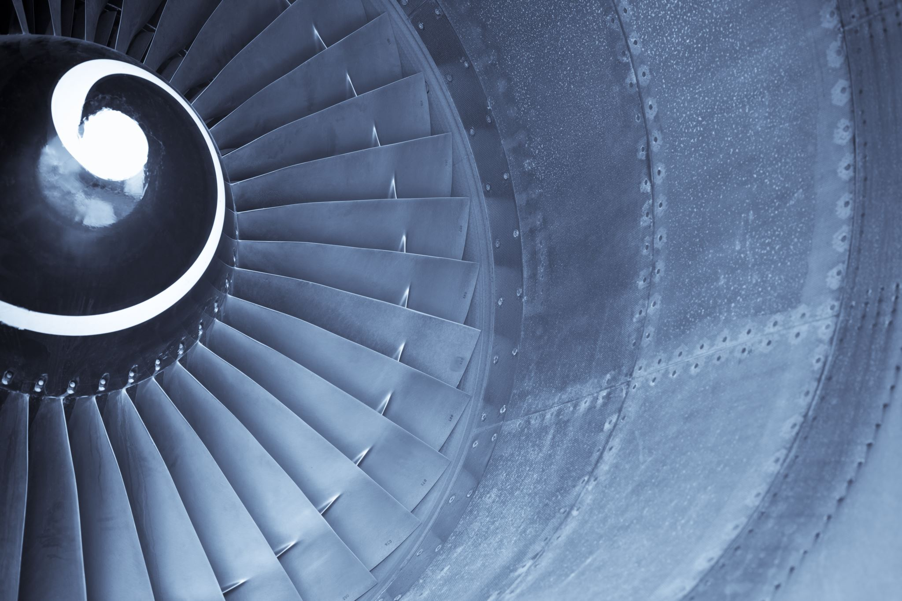

Airline Ticket Re-issues
Donna Dearing
COSC 498 Capstone Project 1
March 12, 2025
Notes:
Hello my name is Donna Dearing and my Capstone Project is for Airline Ticket Re-issues.

Slide 2
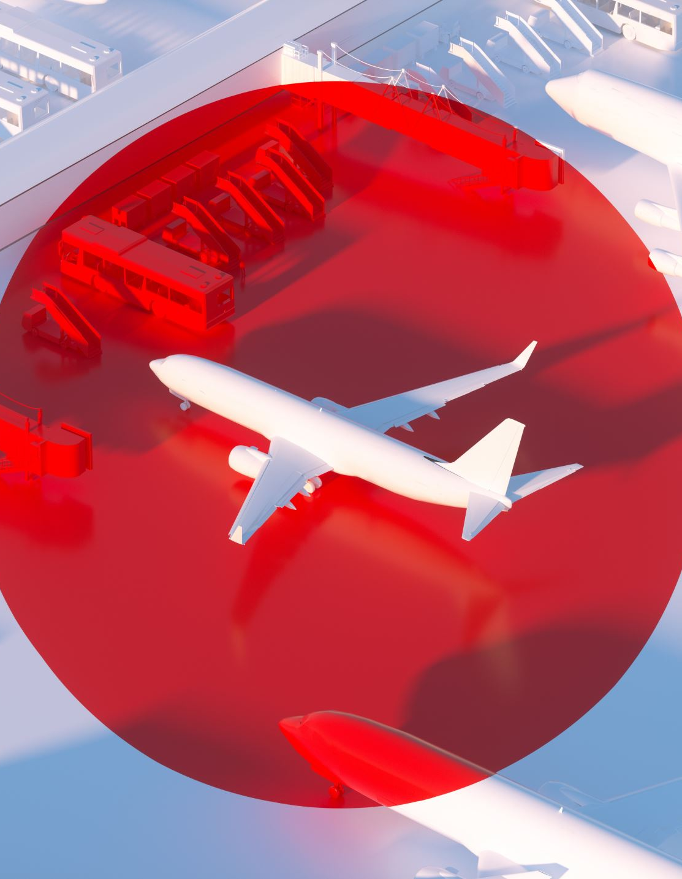
Introduction
This project concerns a solution for printing unnecessary ticket stock when an airline ticket has to be reissued.
When an American Airlines (AA) passenger changes their ticket, whether voluntary or involuntary, the AA Agent must reissue the original ticket to reflect the change.
Otherwise, the passenger will not be able to check-in for that flight to obtain their boarding pass.
Only an AA Agent can reissue an airline ticket; passenger cannot reissue their ticket.

Slide 3
Problem Statement
When the ticket is exchanged/reissued, the reservation system prints the receipt of the fare and the new itinerary that will be flown.
Ticket stock used for the reissue looks like a boarding pass.
However, unnecessary data from the exchange is also printed out on ticket stock, such as baggage data & rules, weight & balance information, and agent information.
The airline agent throws away all unnecessary ticket stock from the reissue except for the receipt and itinerary.
Wasting several ticket stock paper.

Slide 4
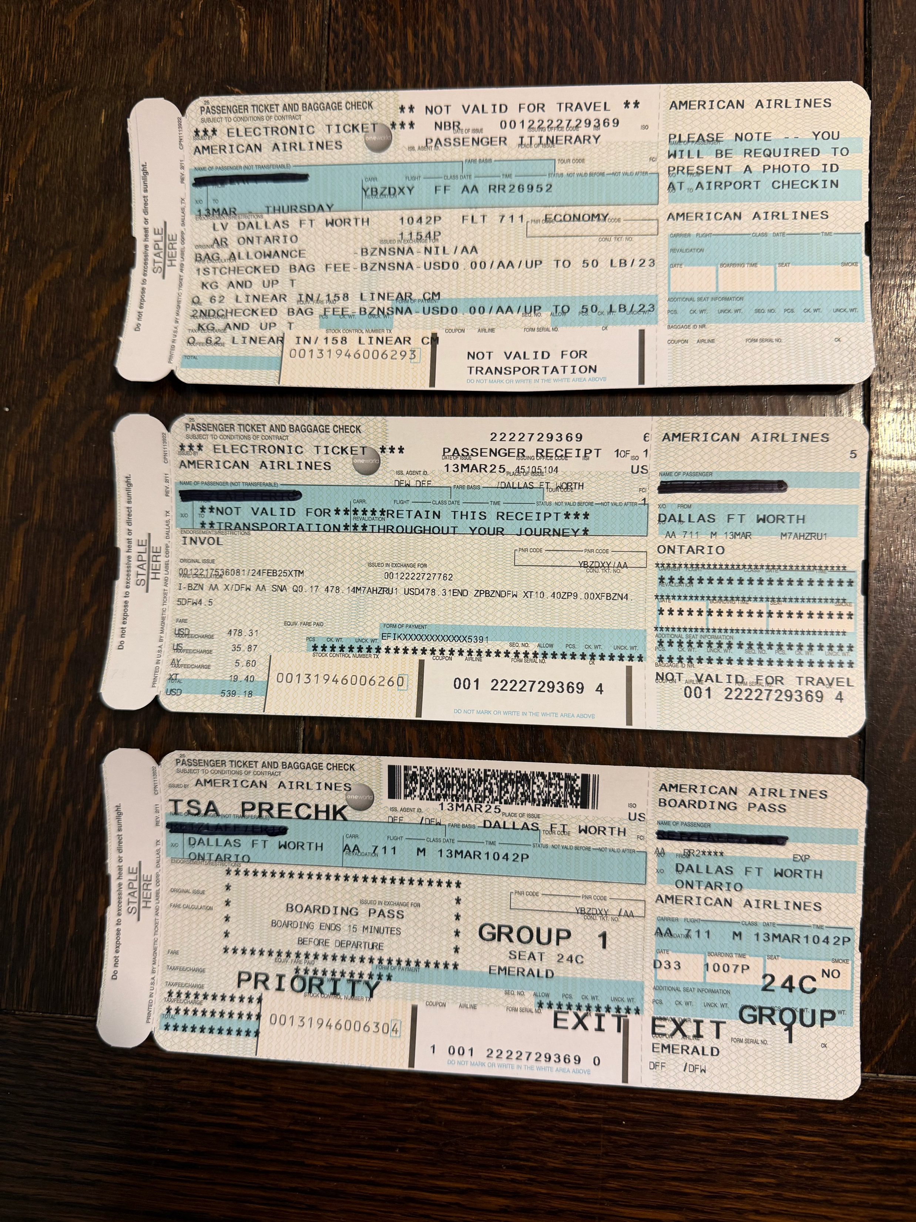
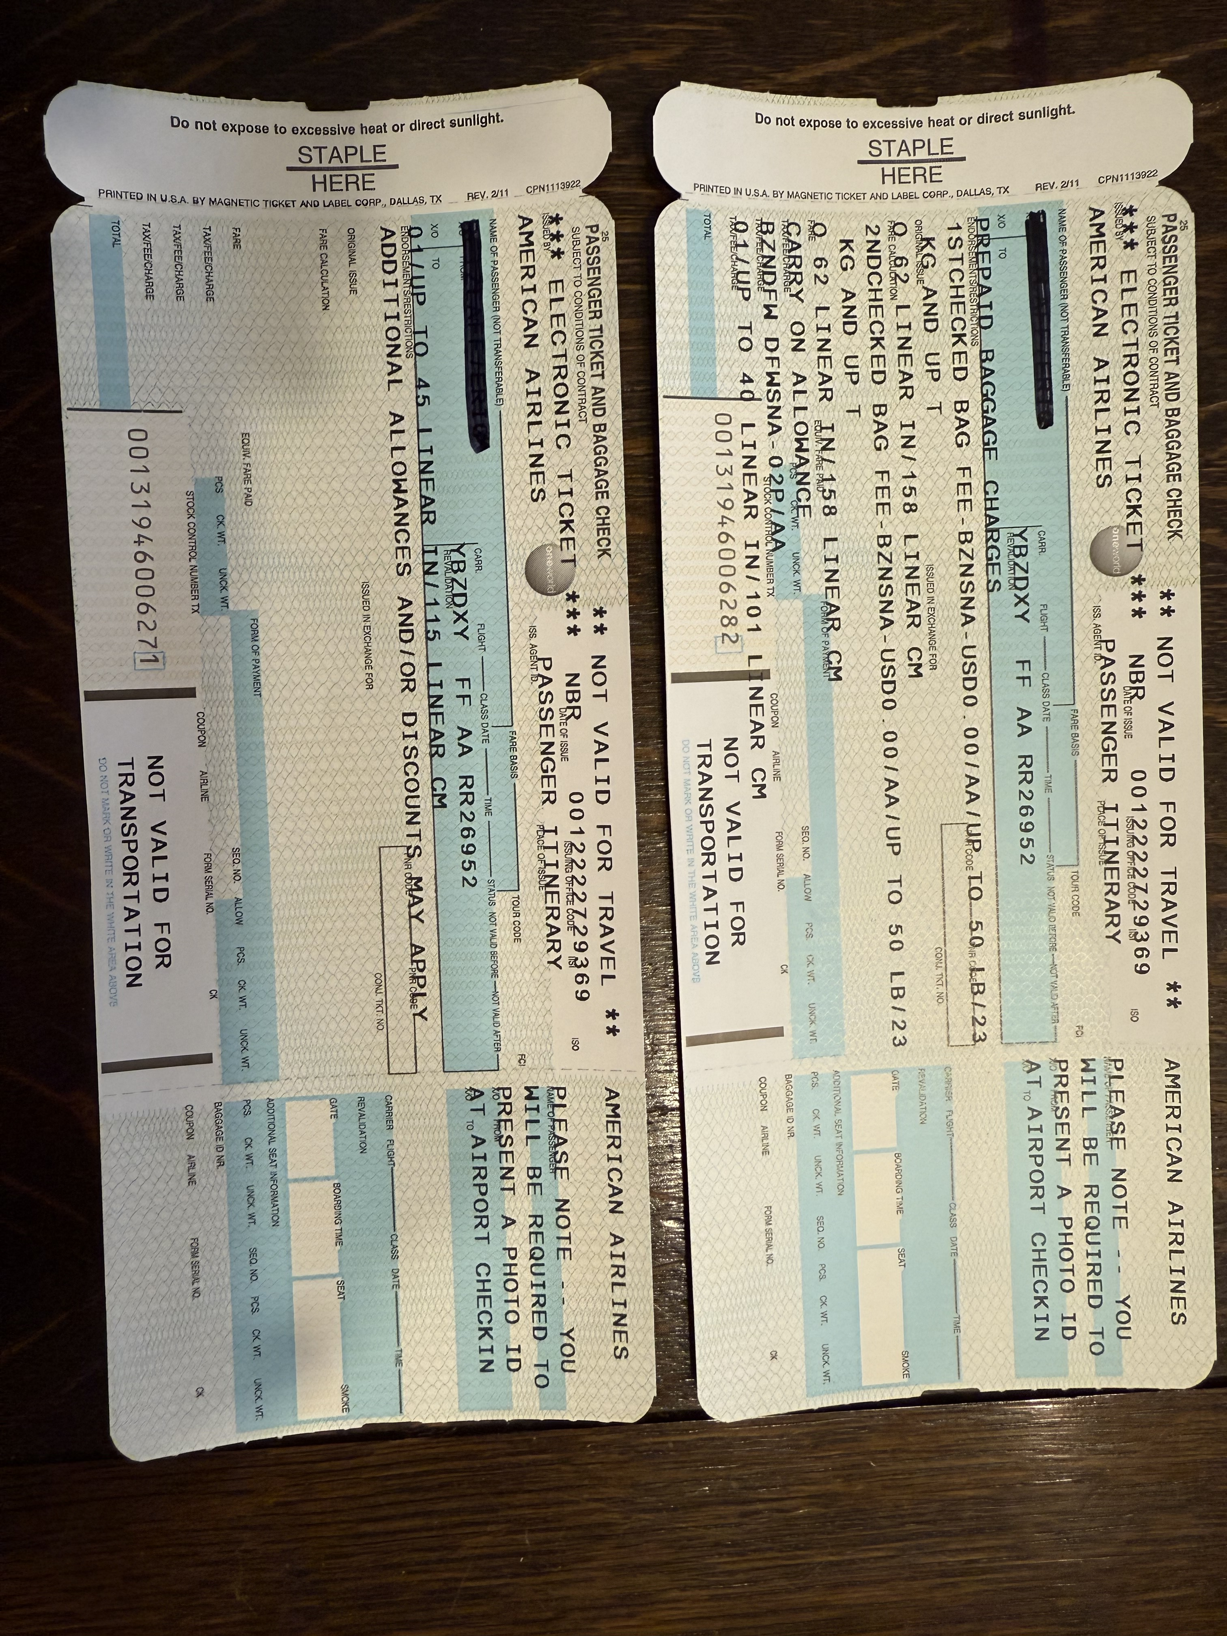
Unneeded Ticket Stock
#1-Itinerary, #2-Fare Info, #3-Boarding Pass

Slide 5
User Persona
During irregular operations (IROPS), where flights are delayed or canceled, a ticket sometimes must be reissued if the passenger has to change their flight.
Only an airline agent can perform a ticket reissue:
Reservations Agent
Airport Ticket/Gate Agent
Airport Service Center Agent
Helpdesk Agent

Slide 6
User Problem-Solving
Current programming must be changed to eliminate the coding that prints the unneeded ticket stock items.
This change would save ticket stock costs, because less pages are printed.
It would also save time to reissue the ticket and obtain only the necessary items (2 ticket stock pieces, instead of 6).
Sometimes during IROPS, passengers have to stand in a long line for a ticket agent to rebook and reissue their tickets.
All printing must finish before the passenger can be checked into their new flight.

Slide 7
User Interaction
By implementing this new change the following will improve:
Less time for passengers to wait for an agent to reissue their ticket.
American Airlines would save money by using less ticket stock when a re-issuance is completed.
Agents would not have to tear off & throw away the unnecessary ticket stock for the pieces they do not need.
In conclusion, saving passengers' time, the agent's time and the company money would justify this implementation.

